Slide 1
The Beginning of Parkside GREEN
Started in 2018
Late 2017: First, solicited residents via word of mouth for interest in having a Green Committee. This began in late 2017.
Then, came up with a mission statement:
To build an awareness of earth friendly, sustainable living practices that improve the quality of life we enjoy in our community, and to have a positive impact on our environment.
Slogan: Good for the community – Good for the environment.
February 2018: the Board of Directors approved Parkside GREEN as an Ad Hoc Committee.
Early 2019: Parkside GREEN proclaimed an official, standing committee.

Slide 2
The Early Days of Parkside GREEN
Developed a logo (not necessary but wanted to establish brand for recognition!)
Set Monthly Meetings
Decided to hold regular monthly meetings on the second Tuesday each month – meetings are open to all
Had a core of about 4-6 committee members for regular meetings and occasional drop-ins.

Slide 3
The Areas of Interest at Meetings
What we did & talked about first
The interest areas at meetings & from residents were:
Recycling 5. Oversized trash
Desire for a Community Garden 6. Green tips for newsletter
Solar and/or Renewable Energy 7. EV charging stations
Litter 8. Educating
IDEAS
Meetings have been a great time to hear about people’s ideas, their interests and also discover desire for the projects certain people might like to work on.
Most of our early work consisted of monthly meetings, discussing ideas and always having a topic assigned for an article that would appear in the community Newsletter. Topics were on recycling, composting, oversized trash, native plants, energy use, tips, etc.
Much of the project energies the first half of the year went into the Community Garden and the garden boxes project.

Slide 4
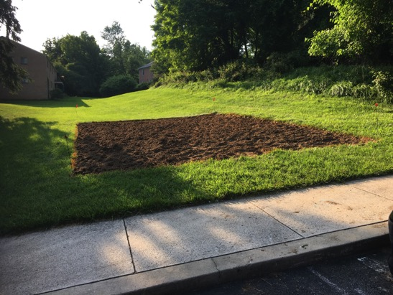
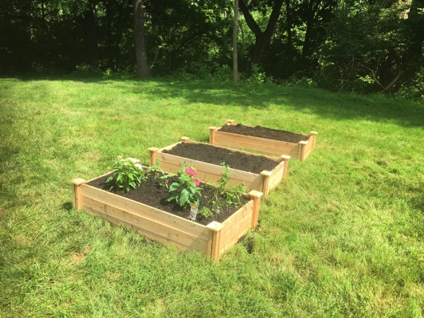
Community Garden and Garden Box
Initiative(s) Approved and Started!
2018
Garden boxes for herbs and perennials sponsored by the Landscape Committee; started with 6 & now 8 boxes in total.
Tilled community garden space– the bare bones of the beginnings of the community garden.

Slide 5
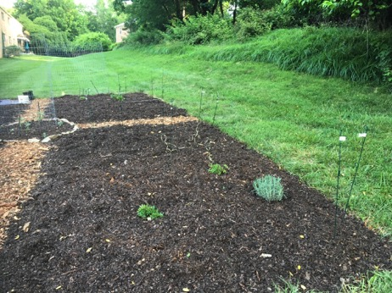
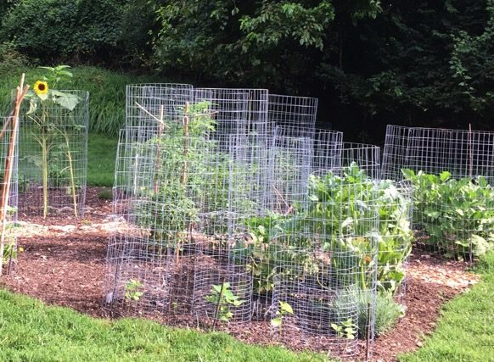
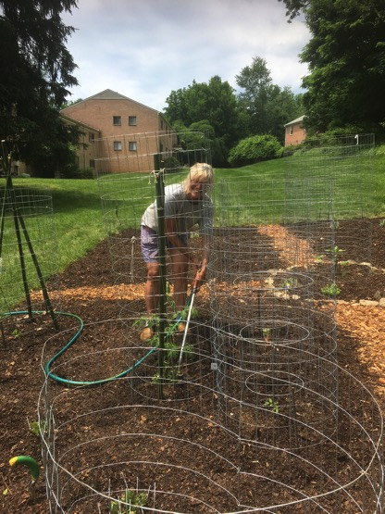
Community Garden
Main goal – have a community garden.
Second goal: protect it from the deer.
Deer fencing approvals took time so the garden group decided to go ahead with first season as an “open garden” with caging to fend off deer.
Was (pretty) successful!

Slide 6
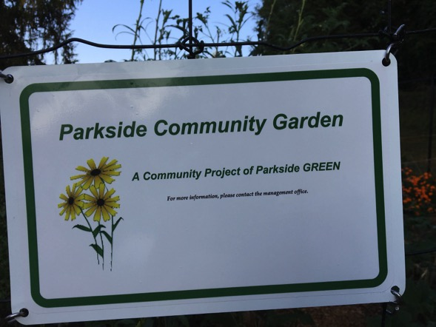
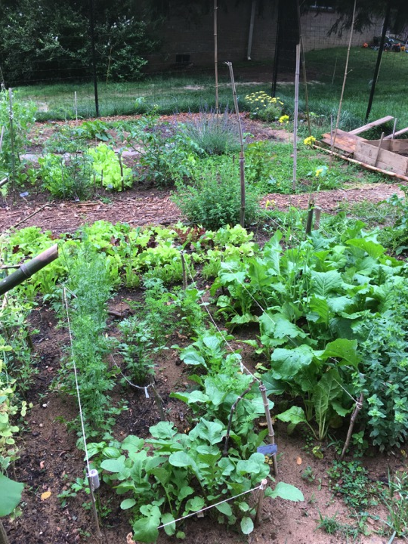
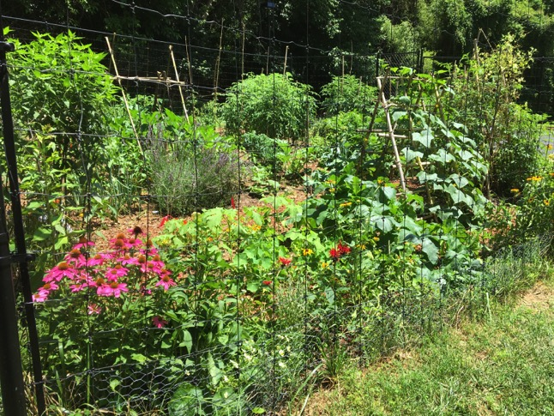
Community Garden
A flourishing garden season with deer fencing!

Slide 7
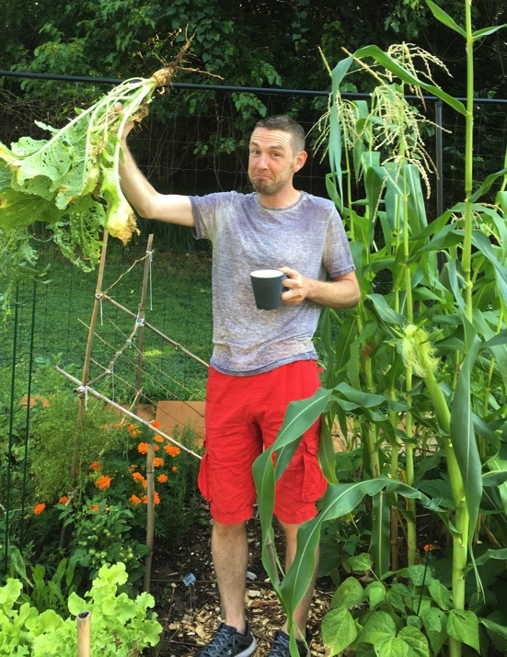
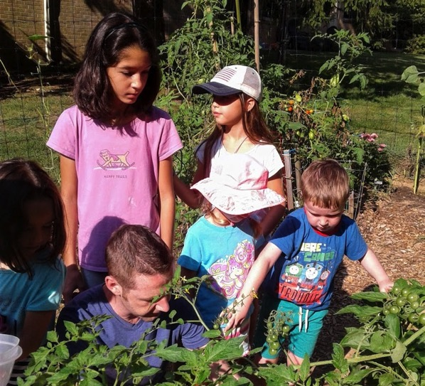
Community
Garden
Appeals to all ages

Slide 8
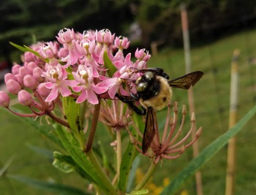
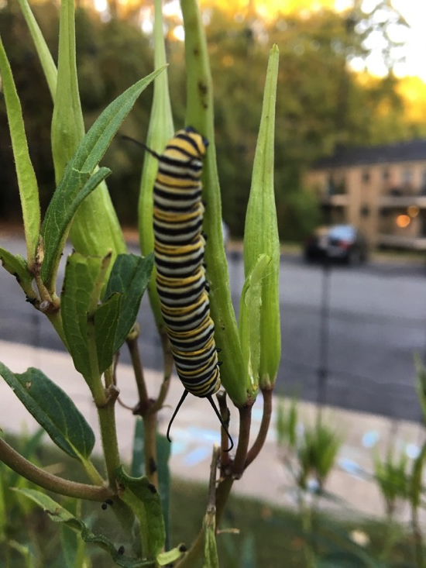
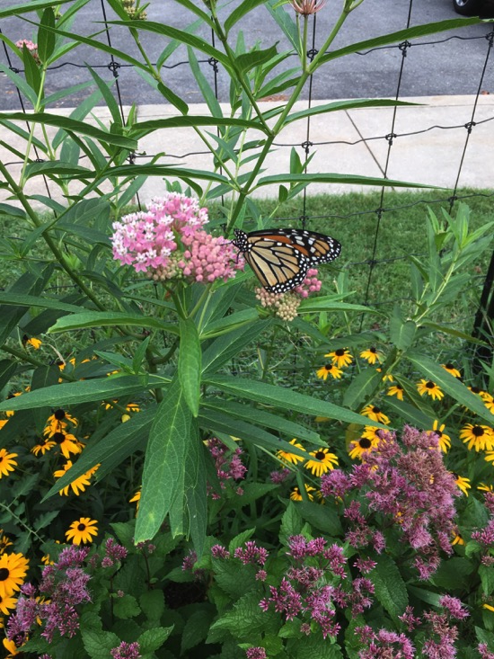
Community Garden
Native perennials are planted around inside perimeter of the community garden:
- Milkweed
- Purple Coneflower
- Obedient Plant
- Black Eyed Susan
- Purple Aster
- Bee Balm
- Yarrow
- Joe Pye Weed

Slide 9
Community Garden
Garden size is 30 x 35
Set up as a “Communal Garden Experience”
The garden is a “communal” garden experience, without assigned plots, where everyone shares the work and the crops – (set up this way for more people to be able to participate).
Activities for the Gardeners have included:
Garden “group work” days
Pre-season and Post-season meeting on plans, what went well, etc.
“Mulch and Leaf-gro Runs”
Kids “seed collection”
Scavenger hunt
Activities at the Garden for the Community have included:
Open House Sampler Days – designated afternoon for “garden tour” and pick and choose a sample of herbs, ready to harvest produce
Garden Party Potluck – (pre-Covid) Gardeners prepared food made from ingredients from garden and had a “garden party” for community.

Slide 10
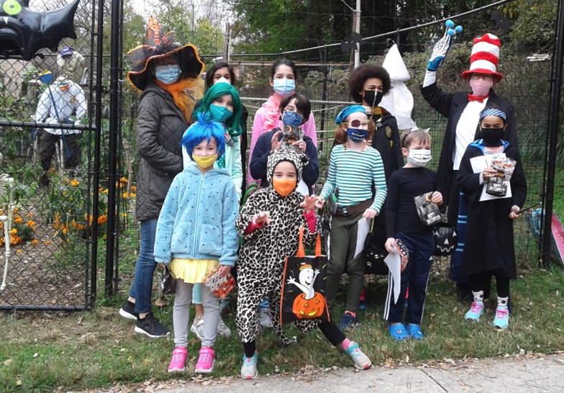
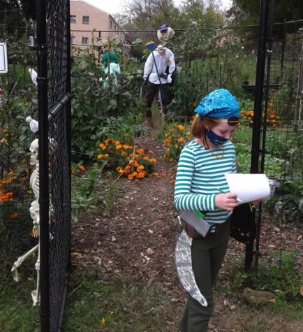
Community Garden
Garden Scavenger Hunt activity on Halloween for the gardener kids

Slide 11
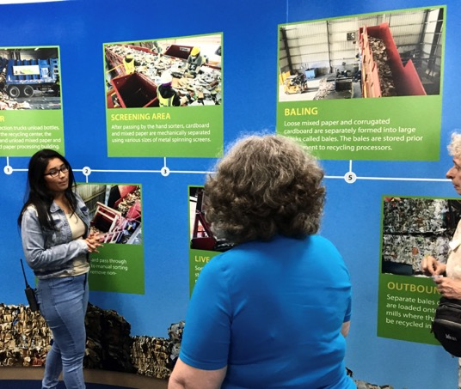
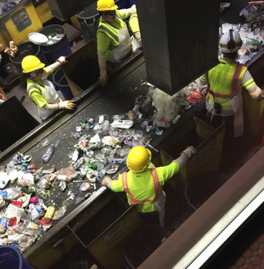
Proper Waste Disposal
& Recycling Awareness
Many residents are concerned about proper recycling
1. Field Trip to the Montgomery County Recycling Center
2. Put tips in newsletters
3. Educate at information
tables/ community days
Reach out to Montgomery County DEP for resources and assistance.
Buddy up with county on “door hanger” program

Slide 12
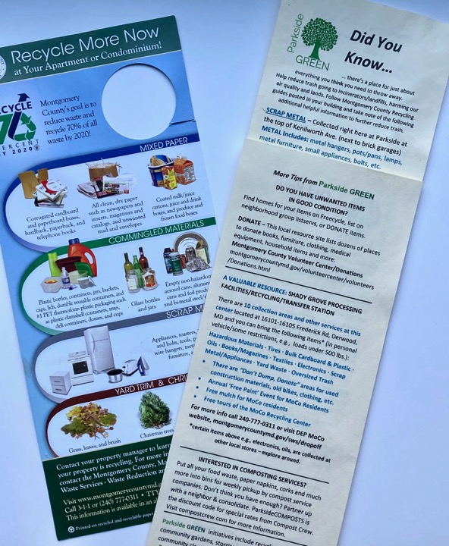
Buddy Up Door Hanger Program: Recycling, waste and a place for everything
Montgomery County DEP (Recycling and Management Resources Division) and Parkside volunteers buddied up to distribute door hangers to all resident homes.
Did You Know…
We developed our own Parkside GREEN info card to supplement the county recycling information. This included e.g. resources for donating items, composting services, local retailers that collect certain items for recycling, etc.

Slide 13
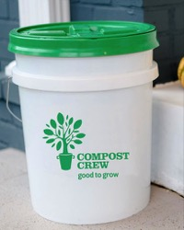
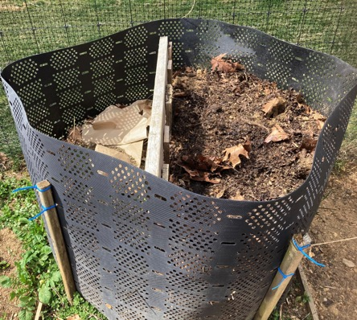
Waste Disposal: Promote Composting Services
Promote composting – at local merchants, with a pickup service, and at the garden
Compost bin at Community Garden for minimal brown & green dry composting; no food waste. (besides coffee grounds, tea bags and egg shells).
There are a few different compost service companies in Maryland/they tend to focus on different neighborhood areas without overlap. Check out:
CompostCrew.com and VeteranCompost.com
Compost Crew has a pickup service with special pricing for our area/community. Interest and participation increases slowly each year as more people become interested and learn about the benefits.

Slide 14
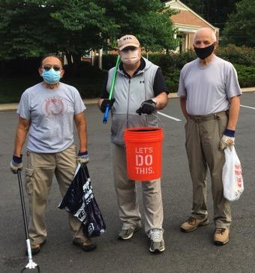
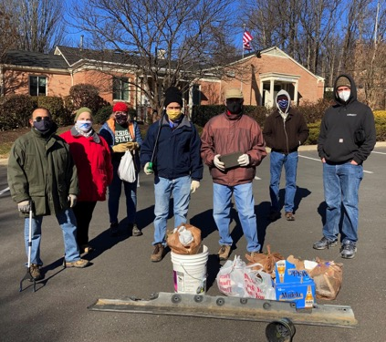
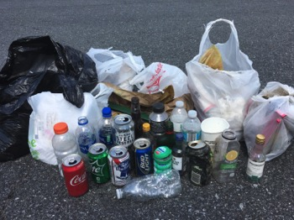
Litter Walks – Plogging
Parkside Green is Talkin’ Trash
Litter Walks have been a regular ongoing activity with dedicated “regulars” and also newcomers. Started as once a month, and have often been twice a month; also do year-round now. The weekend litter walks supplement the grounds maintenance staff who pick up during the week.
Team’s Caption: “Litterly Most Wanted: Armed and Dangerous ... To Trash.”

Slide 15
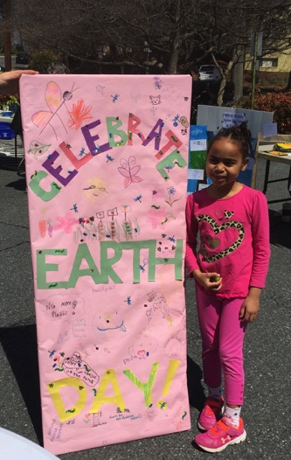
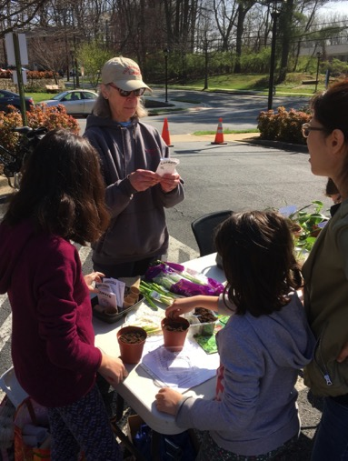
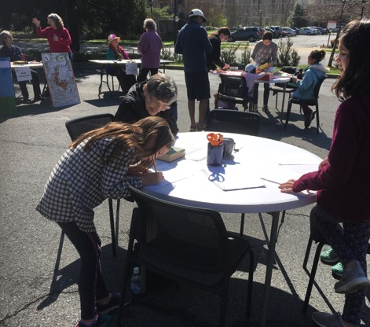
Earth Day Events and Activities
Group activity making Earth Day sign
Plant an herb or veggie to take home
Other Activities/Info tables:
Poetry table, Compost Crew, Plastics Info, Drawing wildlife at Parkside, Weed Warrior, Recycling quizzes, etc.

Slide 16
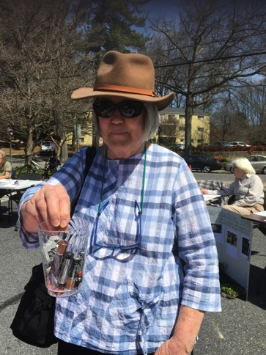
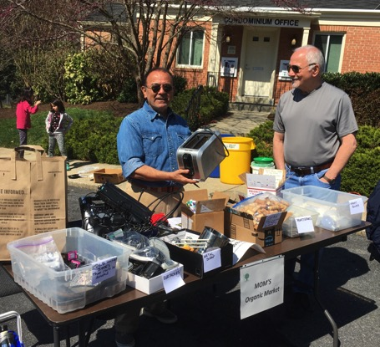
Earth Day Collection Activities
Electronics, batteries, corks, scrap metal, ink cartridges, old shoes, etc. collection for recycling
Parkside staff took all electronics, larger items to county transfer station
Took old shoes, batteries, corks to MOM’s Organic Market
Let people know what they can do with things throughout the year.

Slide 17
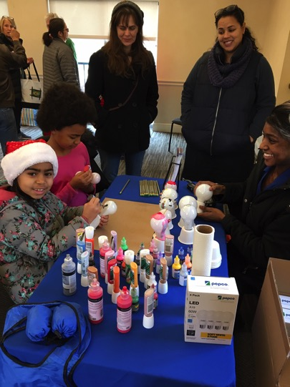
Community Events
The community events
have been great social and interaction times where neighbors can meet each other and re-connect.
are great way to inform and educate.
Lots of people come with questions!
What do I do with this?
Great way to involve people of all ages.
Reach out to county DEP to help with events
Light Bulb Exchange & Bulb Decorating Holiday Community Event

Slide 18
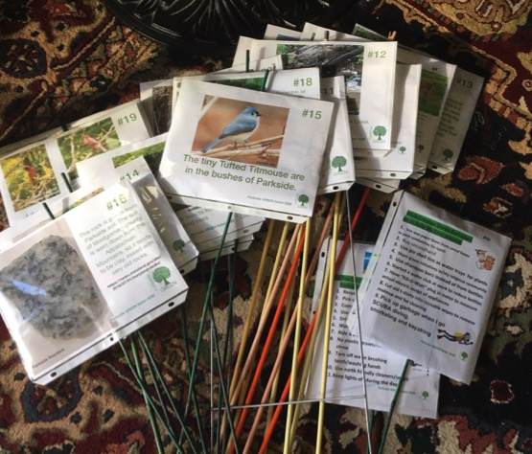
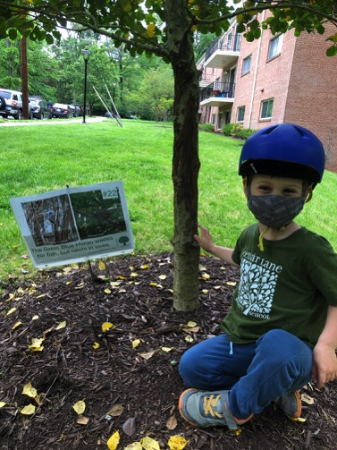
Earth Day 2020 Cancelled
Pandemic Year Activities Changed
Safari Scavenger Hunt
Placards related to nature, wildlife, earth day, recycling, etc. were staked throughout property & participants had
three weeks to complete the scavenger hunt at their leisure.
Young and old alike participated.
An independent and family pod activity

Slide 19
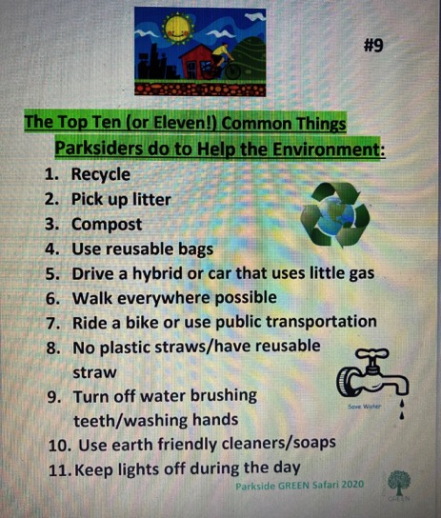
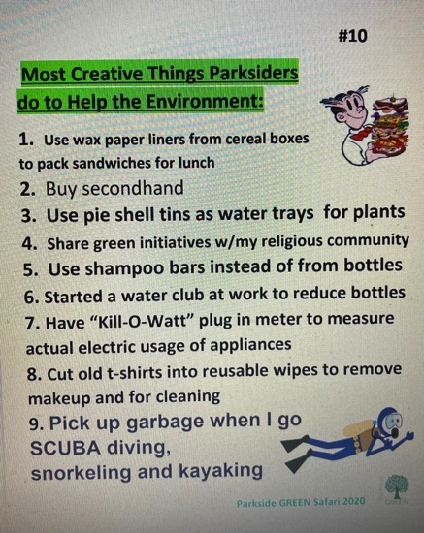
Tell us Three Things You Do to Help the Environment
Solicited community and received dozens of things people do-
people enjoyed being asked; anyone who submitted had name in raffle drawing

Slide 20
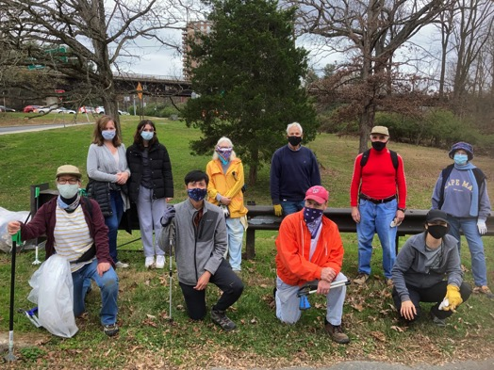
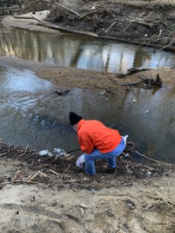
Stream Cleanups
In cooperation with Rock Creek Conservancy and Montgomery County Parks
In 2020, a few members became Certified Team Leaders for the Rock Creek Conservancy.
We organize 2-3 Cleanups a year along Beach Drive/Rock Creek near our condos. These are for Parkside residents, family & friends, keeping them as community events.
The initiative with Rock Creek Conservancy overlapped with

Slide 21
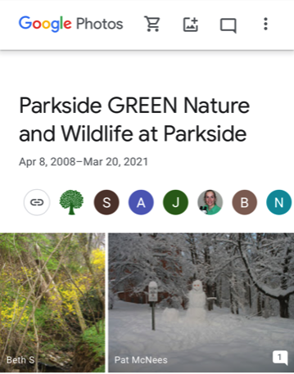
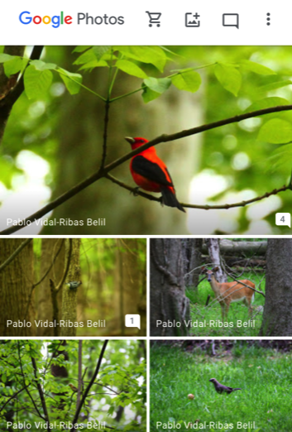
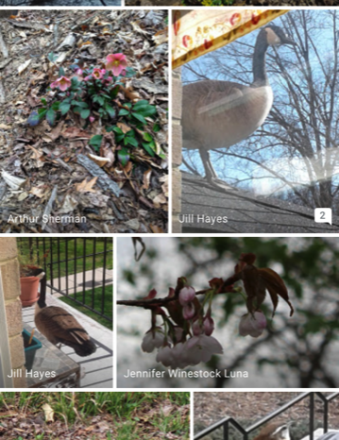
Google Photo Board –
an easy & fun community involvement project

Slide 22
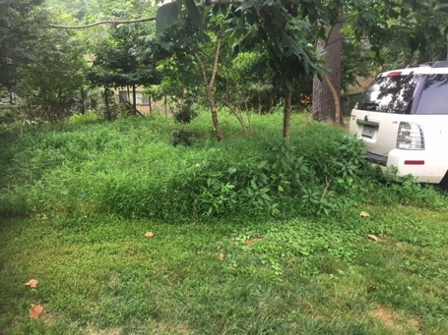
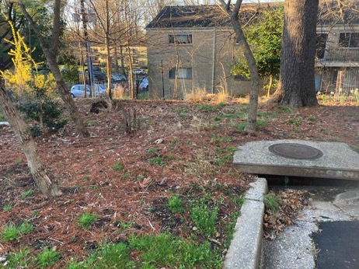
Invasive Removal & Native Hill Project
Before – 2018
After – 2021
A few dedicated volunteers in the community and a few years of hand-work to get rid of Japanese stiltgrass.
Enjoy a bit of labor? Better than the gym!
This area is between backs of buildings/parking lots, and is grandfathered in from days on Landscape Committee as a Native plant project area – small volunteer team tend to it and test “deer resistant” native plants.

Slide 23
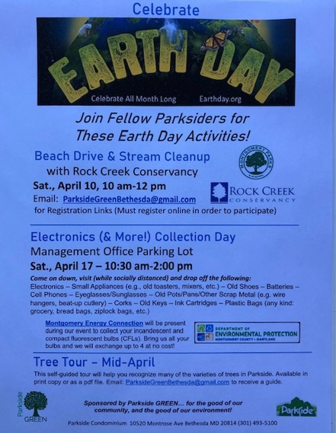
How we get the word out on events:
Community Newsletter/Bulletins
2. Email News to Listservs
3. Bulletin Board Flyers
Next up is Earth Day 2021: a clip from our bulletin and enews:
Parkside GREEN …invites you to Celebrate Earth Day all month long in April!
April is a time to give extra recognition and honor to Mother Earth –
we hope everyone finds a great way to commemorate Mother Earth during this period.
Join Fellow Parksiders for Rock Creek Conservancy's 13th Annual Extreme Cleanup Day
Saturday, April 10, from 10:00 a.m. to 12:00 p.m. (details)
Electronics and More (!) Earth Day Recycling Collection
Management Office Parking Lot Saturday, April 17, 10:30 a.m. – 2:00 p.m.
Items Collected
Electronics – Small Appliances (e.g., old toasters, mixers, etc.) – Old Shoes – Batteries – Compact Fluorescent Bulbs – Cell Phones – Eyeglasses/Sunglasses – Old Pots and Pans & Other Scrap Metal (e.g. wire hangers, beat-up cutlery, etc.) – Corks – Old Keys – Ink Cartridges – Plastic Bags (Any kind: grocery, bread bags, ziplock bags, etc.)
Tree Tour – Learn the Different Types of Trees We Have at Parkside– Self-guided Tour
Mid-April

Slide 24
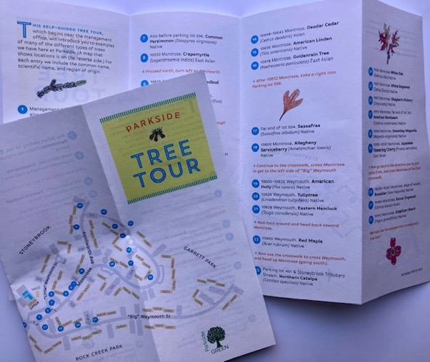
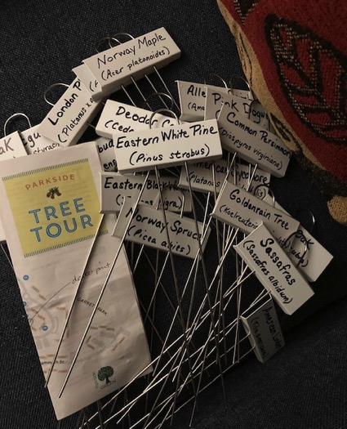
Mid-April – Self-guided Tree Tour
As you take your walks, learn some of the different types of trees we have in the community.
Project involved many contributors as a “Tree Team” (committee members, residents and staff).
Will have a long shelf life – plan to expand another and put more information on web site.

Slide 25
Other Projects (Oh my!)
Never a shortage of ideas, initiatives or projects
Stormwater Management
Solar and Renewable Energy
EV Charging Stations (researched & gave proposal; passed on to ad hoc committee)
RainScapes applications – one for rain garden and one for asphalt removal
Many projects are driven by an interest/ideas from committee members and residents.

Slide 26
Parkside GREEN
Green Teams at an HOA bring so many benefits…to the community, to the environment and to everyone on the team.
Thank You!
Susan Pourian
Parkside GREEN
ParksideGreenBethesda@gmail.com

